Slide 1

Organic Orchard.
Organic
Orchard.

Slide 2
Project: Organic Orchard.
Course Title: Web Programming
Course Code: CSE 479
Section:04
Course Instructor:
Md Mohsin Uddin
Senior Lecturer
Department of Computer Science and Engineering

Slide 3
Group Members
Name | Student ID
Syeda Tamanna Sheme | 2018-2-60-010
Md. Abul Kasham | 2018-1-60-108
Saniat Injam | 2017-3-60-093

Slide 4
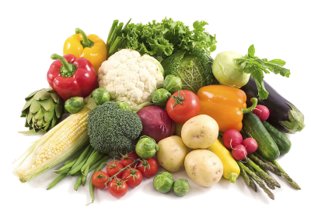
Introduction
Current procedure is a manual procedure.
Numbers are very low.
Decrease overtime pay.
Boost the number of users.
Clients can simply find out information about purchasing and selling supermarket items.
Figure-01: Grocery Items

Slide 5
Purpose
Provide an online grocery showroom and allow users to book products online.
Senior individuals find it difficult to shop offline, they can profit from this service.
Many individuals are unaware of auto buying and selling methods.
Provide the best food based on their budget.
Online payment and home-delivery system.

Slide 6
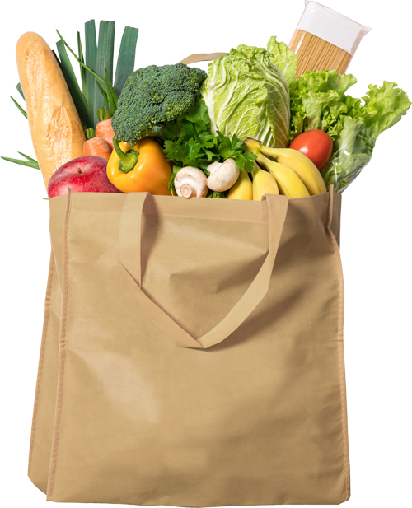
Features
Two Types of User
Admin
User
User Features:
Buy
Product
Cart
Contact Us
About Us
Explore the Website.
Admin Features:
Total Pending
Completed Orders
Orders Placed
Products Added
Total Users
Total Messages
Figure-02: Grocery Items

Slide 7
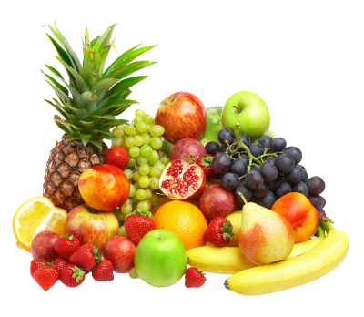
Features
User-Friendly Interface
Hardware Interface
Interface with modern design
Security and Privacy
Maintenance
Figure-03: Grocery Items (Fruits)

Slide 8

Technology
Programming language:
PHP
JavaScript
Database:
MySQL
Frontend:
HTML
CSS
IDE/Editor: Visual Studio.
Version Controlling System: Git.
Figure-04: Grocery Items

Slide 9

Project
Demonstration

